Slide 1



Ing. Milan Turek, M. Sc. 27.8.2020
www.etstech.cz

Slide 2
About company
Company ETS technology SE was founded in 2015. Its origins, however, dates back to 1995 when the company Elisch + B electro was founded. At the time, in an old warehouse in Pribram, they've began trading with electrical material. In 2005 they bought the land in a lucrative place in Pribram and built a new headquarters. A year later it became a limited company. Gradually, they began to construct reputation among competitors and managed to push through. In 2010 the company's turnover exceeded 200 000 €.
The company began to cooperate with engineering firms and slowly began to supply material to the automotive industry. Elisch allocated a team of capable persons and created company Elisch Technology, which was renamed to the ETS Technology SE. The company has decided to rent an office in the city of Sušice, where they acquired machining equipment.
In 2016 we have bought a new CNC turning lathe and CNC machine centre. For this reason rented hall in Sušice was not be sufficient for us, therefore we built up a new hall in Příbram in end 2018. Paraelly we established new team in Hluboká nad Vltavou and right now we are starting new building project in Radonice and finilizing new team in Příbram.
We are small company with big targets , which always concentrate on strong customer focus. 20 years of experience give us good way to develop our company according customer requirements.

Slide 3
Company strategy
- strong customer focused
- right timing with transparent follow up
- quality guaranty
- company development step by step

Slide 4
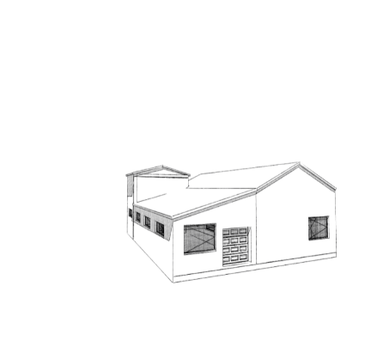
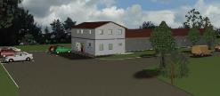


Building projects
New hall in Příbram 400 sqm 2018
Reconstruction of Elisch Electro end of 2019
New areal in Radonice
Spring 2020

Slide 5
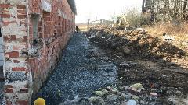
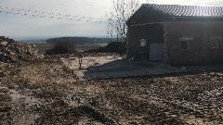
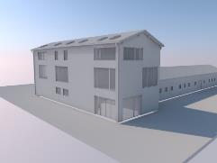
Building projects
ETS Radonice
- 10 000 sqm available
Possible expansion
Air conditioned measurement room
8 x CNC machines
Building permition already valid
SOP end of 2020 !!!
Planned investment
3D measurement table
5 axis center
Electroerosive machine

Slide 6
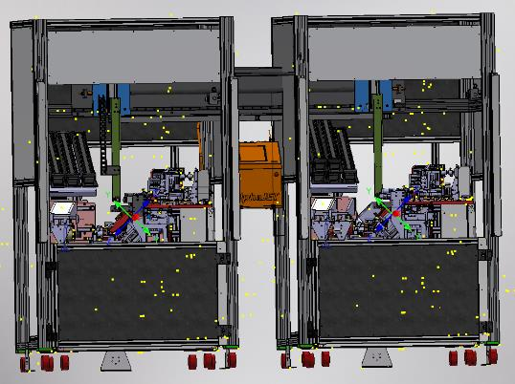
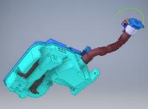
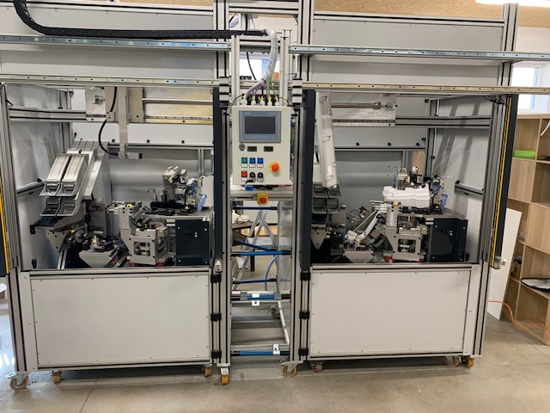
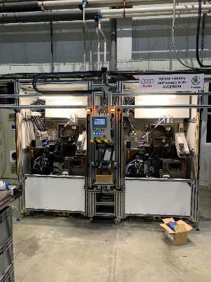
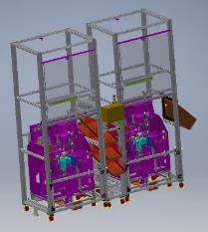
Our products – assembly machines
Machine for AUDI wasching container
Machine for MEB3L VW platform wasching container
hot air welding
stamping
leak test
printing
hot air welding
stamping
leak test
Ink. Printing

Slide 7
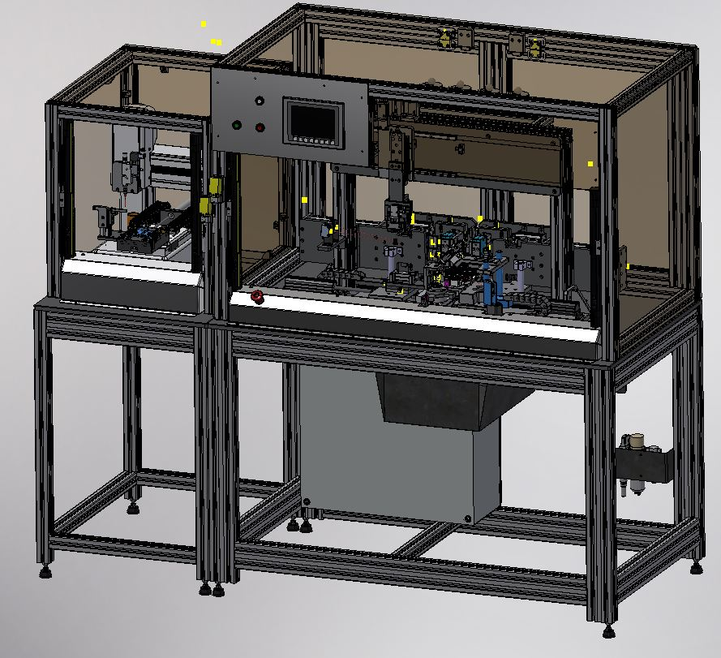
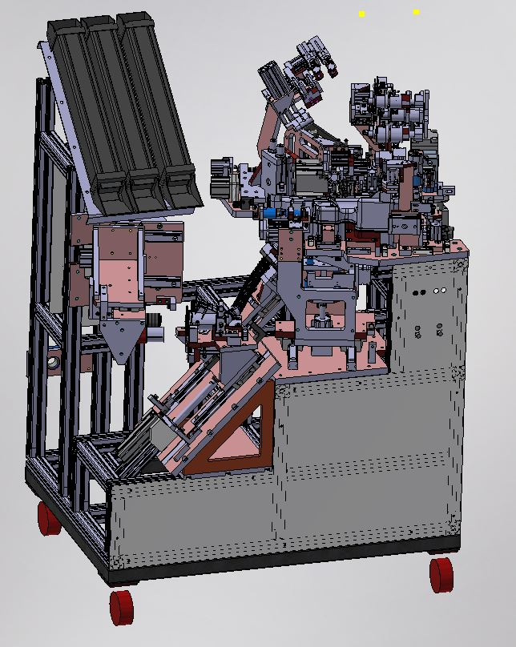
Our products – assembly machines
Škoda Fábie – assembly of lockers (6types)
MEB6l – wasching container
stamping
Vibration conveyor
Robotics lubrification
assembly
hot air welding
stamping
leak test
Ink. Printing

Slide 8
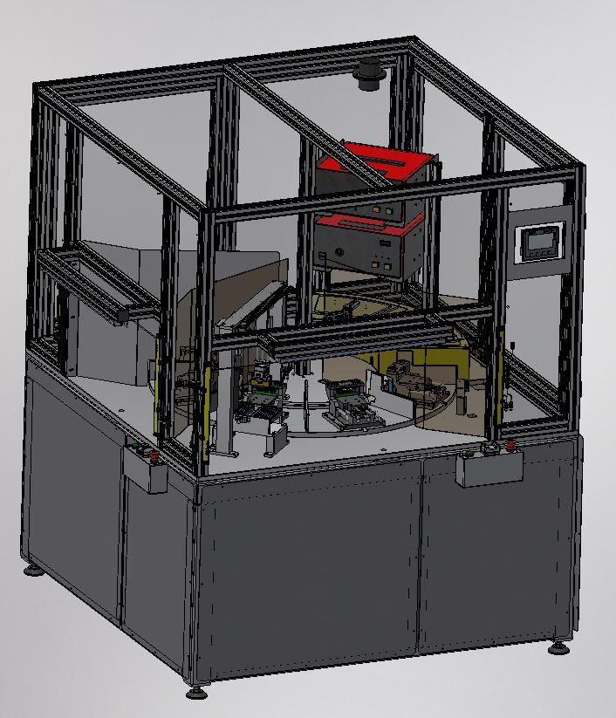
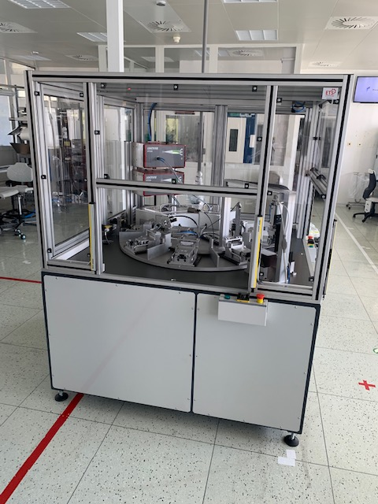
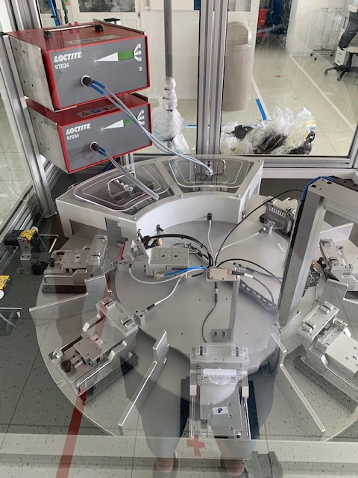
Our products – assembly machines
Completation of DNA pipets
Gluing loctite
Henkel lamps
8 position electric table
assembly

Slide 9
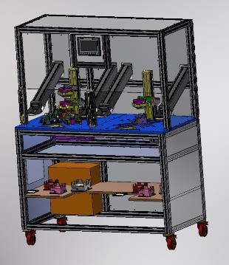
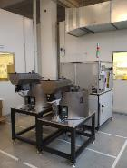
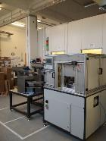

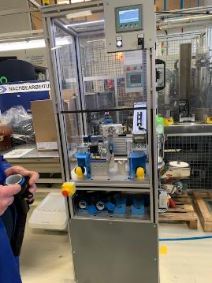
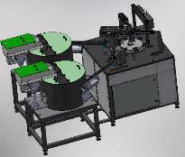
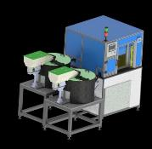
Our products – assembly machines
Machine for filler neck Renault
Machine for electric boxes completation
semiautomatic machine CT 4 sec, medical industry
Pressing
Camera test
Assembly
Marking
Clamping of parts by Vacuum
Pressing
Rotating table 6 station
Camera test (separation OK/NOK parts)
Vibrations conveyor

Slide 10
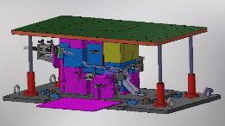
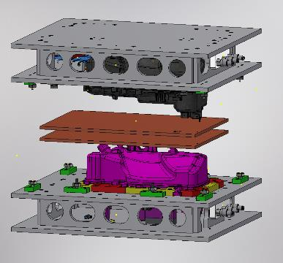
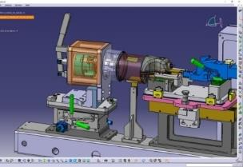
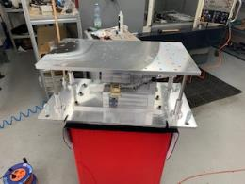
Our products- welding fixtures
Welding fixtures for plastic material
Welding fixtures for metal material
Hot plate welding
Ultrasonic welding
Vibration welding
MIG/MAG welding - with quick changeover beam Daimler Project
TIG Welding - VW project

Slide 11
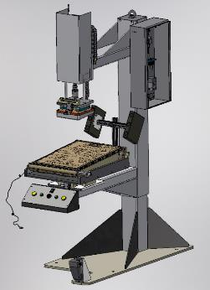
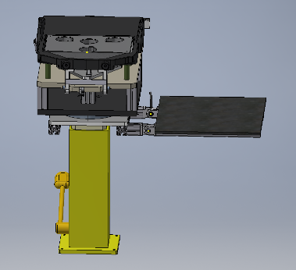
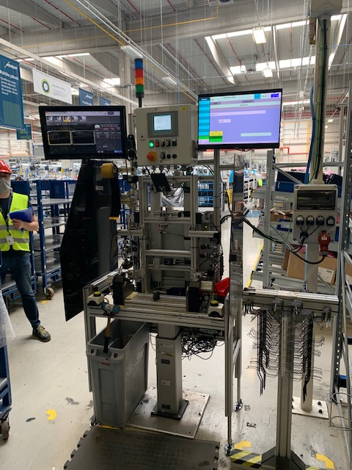
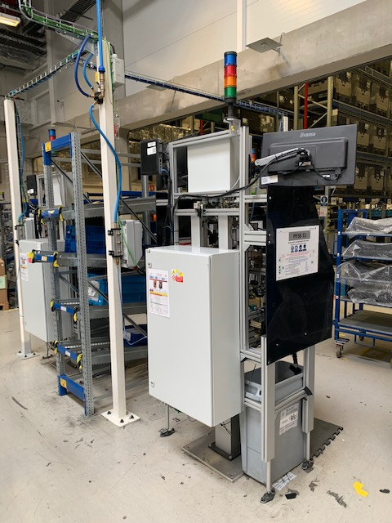
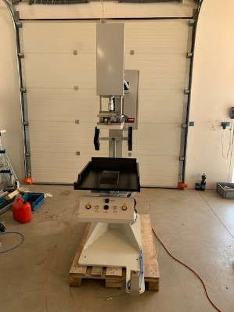
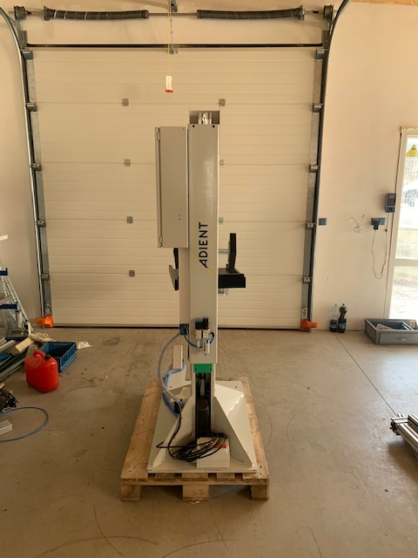
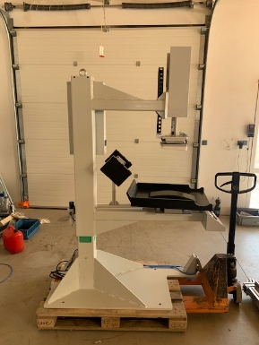
Our products - Adient
Pressing machine for manuall assembly of seats
Nový bor
SOP end of february
New concept of hoogring station to improve actual process
Nový Bor
On Going
Complete Refurbishment of PFSB station including new connection to main electric distribution point (canalis system)
Nový Bor

Slide 12
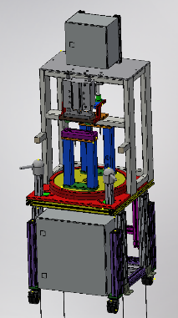
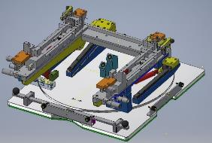
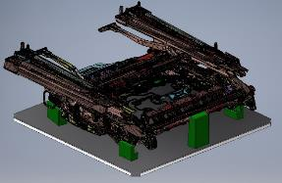
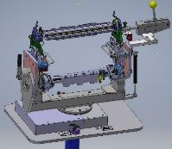
Our products - Adient
Pressing machine, BMW project
Nový Bor
New concept of ergo palet and Flex palet line
Nový Bor, Adient Slovakia
Front seats back cuschion adaptor
Meerane

Slide 13
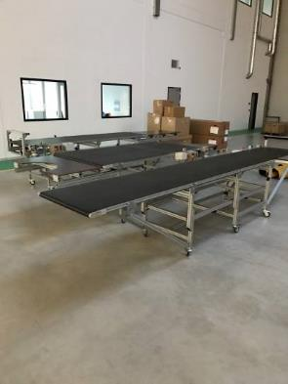
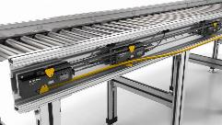
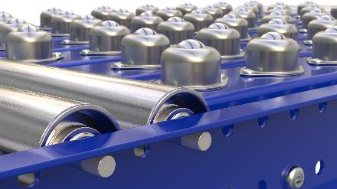
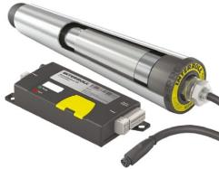
Our products - Conveyors
    Belt conveyors
    Interroll Conveyors (with integrated engine inside rollers)
    Ball conveyors

Slide 14
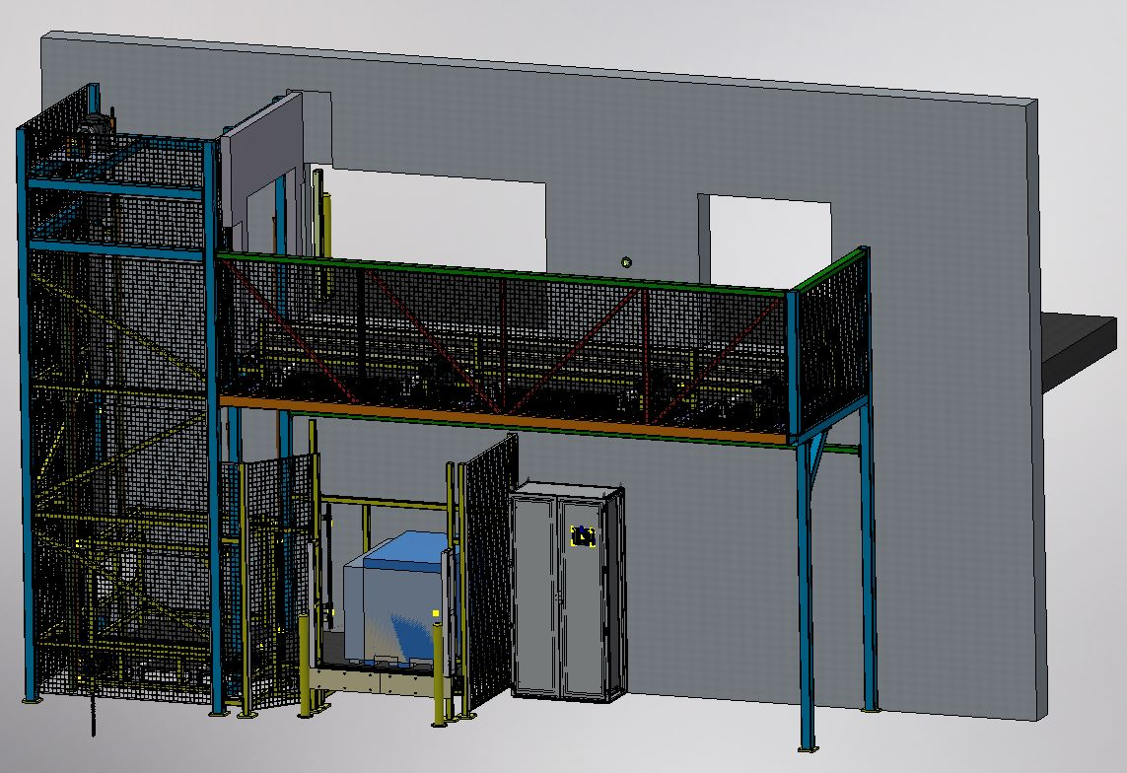
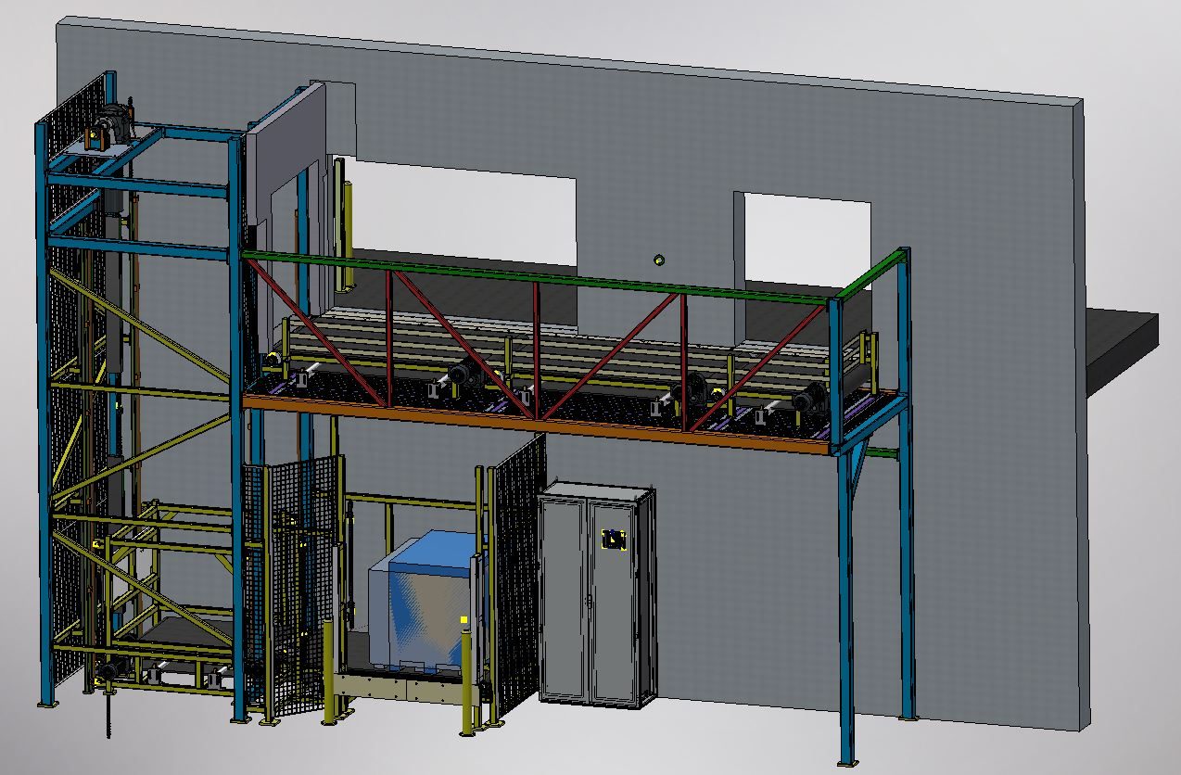
Our products - Conveyors
    Modular Conveyor with lift to the first floor
    Maximum weight 500kg
    Speed 0,4m/s

Slide 15
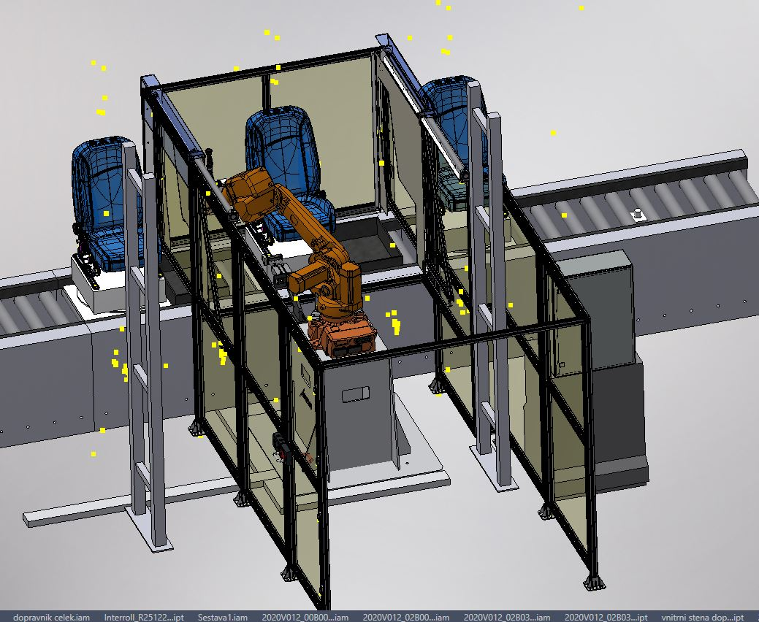
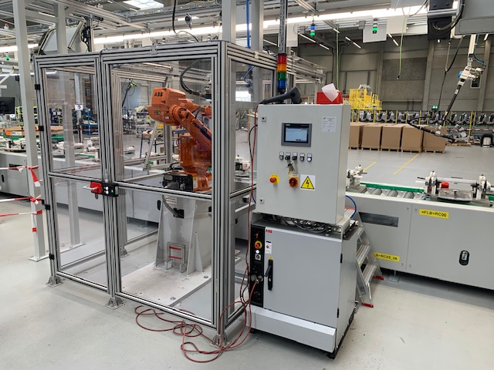
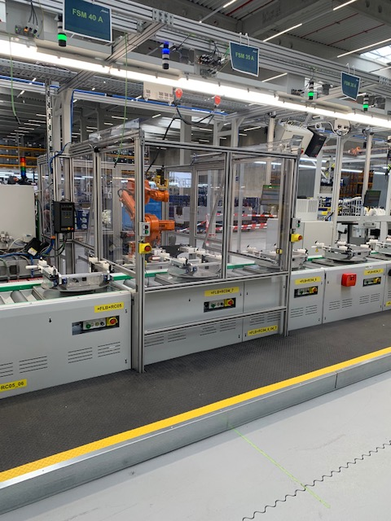
Our products – ROBOTS implemetation
    Screwing ROBOT IRB2600 with smart view vision system
    CT25 sec

Slide 16
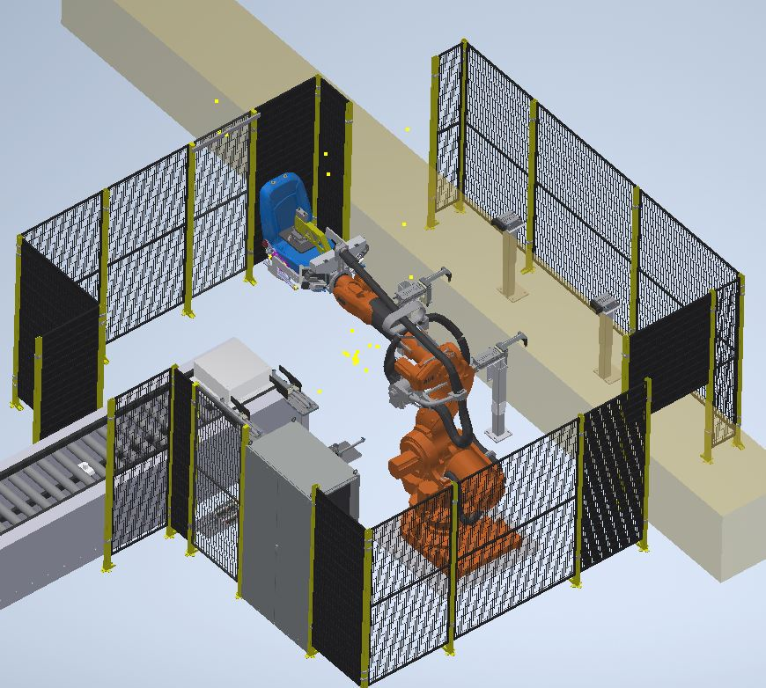
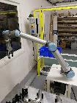
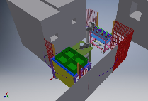
Our products – ROBOTS implemetation
    Shipping ROBOT ABB IRB6600
    Manipulation with seats from production pallet to shipping pallet CT25s
    Cobot implementation
    End froming of tubes
    Drilling
    Wasching
    Release of 1 operator for 3 shifts

Slide 17
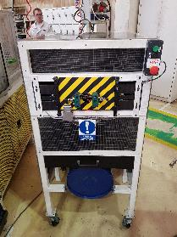
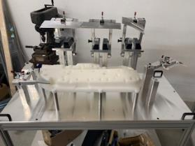




Our products – cobots, manipulators, manual fixtures
    3 axes manipulators
automatic cutting machine
automatic deburing machine
manual fixtures …. ect

Slide 18







Our products – refurbischment, control gauges ect…
    Refurbishment IO sizing Machines, needle machine, deburing machine for needle
    Quality tables equiped by fixtures for ergonomic handling and by special lights
    Control Gauges we are producing around 40 Control gauges per year for automotive industry
    Supermarkets/flow racks/shop stocks for logistic, implementation of electronic labels (conection with SAP). Pick to light systems

Slide 19











Customers

Slide 20
We look forward for further cooperation
Ing. Milan Turek, MS.c. 7.2.2020
www.etstech.cz

